Slide 1
Comparing performance of standard q-learning to deep q-learning in custom gridworld for competitive and cooperative tasks
Team 2
CSE 616: Multi-Agent Systems
December 08, 2022
Instructed by: Dr. Vereshchaka
Presented by: Kishan S. Patel

Slide 2
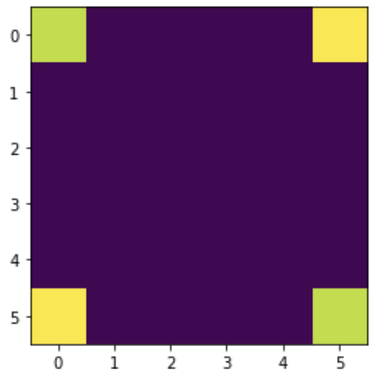
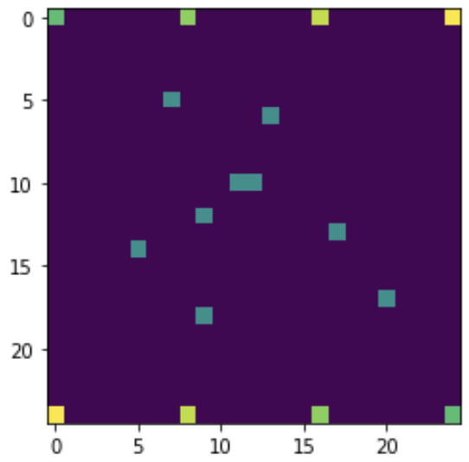
Project Description
Custom grid worlds created to evaluate Q-Learning and Deep Q-Learning Agents in cooperative and competitive settings
Size and obstacles of grid worlds varied in order to test the strength of both agents while increasing comlexity
Agents evaluated on reward per episode and timesteps per episode
First was a competitive task of agents to reach their goal state as quickly as possible irrespective of the other agents
Second task was cooperative aimed at navigating the obstacles and reaching the goal states as a collective
2 Agent 6x6 Gridworld
4 Agent 25x25 Gridworld with 10 Landmarks

Slide 3
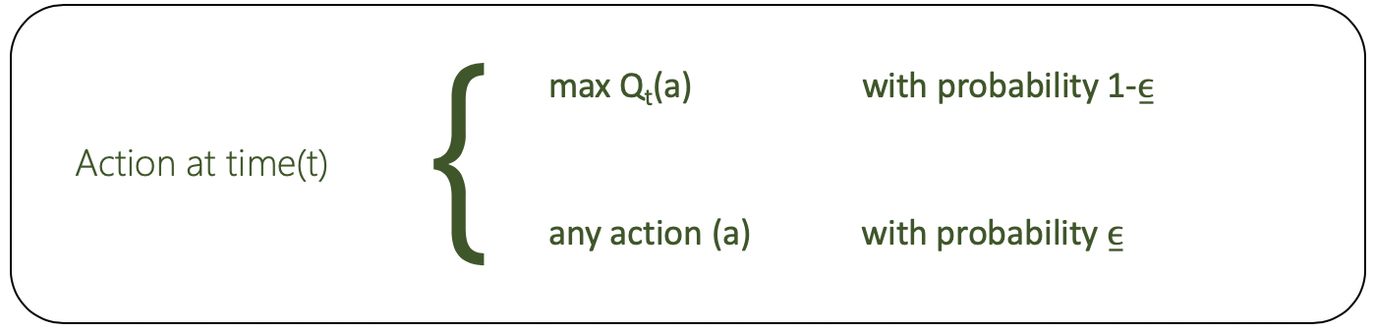
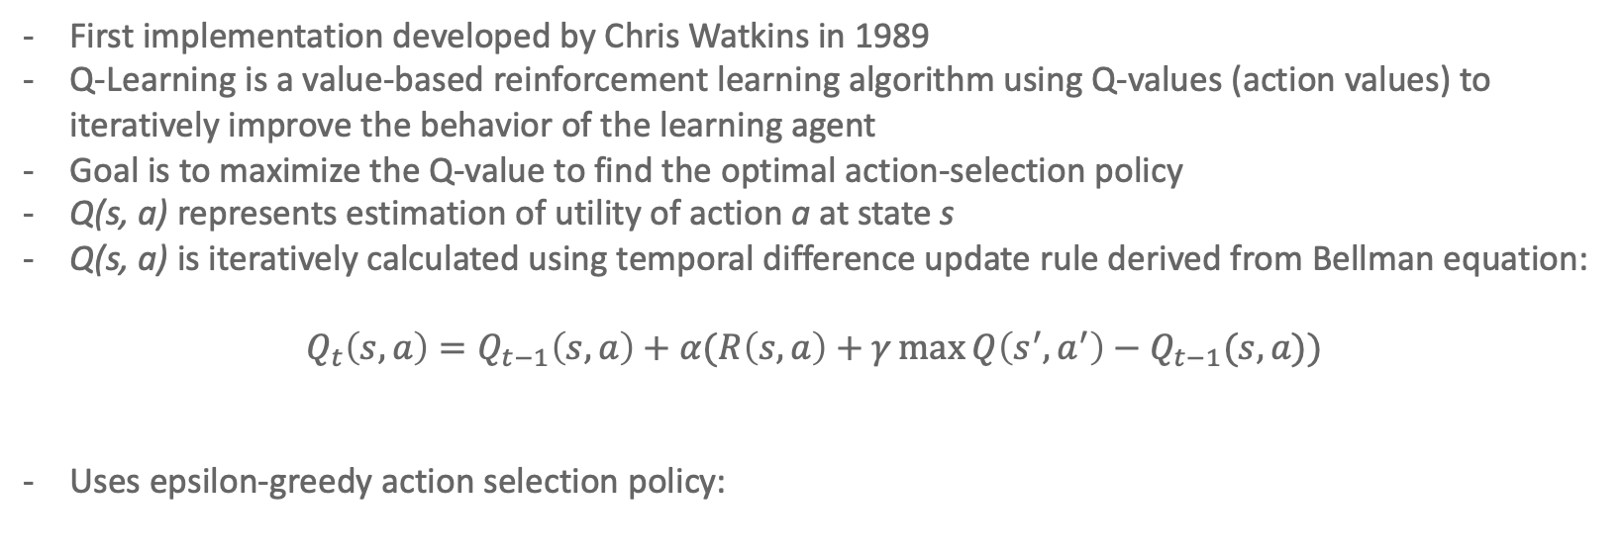
Background – Standard Q Learning
First implementation developed by Chris Watkins in 1989
Q-Learning is a value-based reinforcement learning algorithm using Q-values (action values) to iteratively improve the behavior of the learning agent
Goal is to maximize the Q-value to find the optimal action-selection policy
Q(s, a) represents estimation of utility of action a at state s
Q(s, a) is iteratively calculated using temporal difference update rule derived from Bellman equation:
$$Q_{t}\left(s,a\right)=Q_{t−1}\left(s,a\right)+α(R\left(s,a\right)+γ\max{Q\left(s^{′},a^{′}\right)−Q_{t−1}(s,a))}$$
Uses epsilon-greedy action selection policy:

Slide 4
Background – Deep Q-Learning
Developed by Google DeepMind in 2014
Uses deep neural networks to estimate the action-value function Q(s, a)
Network takes in current state of environment as input, and outputs expected future reward for each possible action; agent chooses action with highest expected reward
Deep Q-Learning uses experience replay during training to store and learn from past experiences
Involves storing a replay buffer of past experiences and sampling from buffer to train the neural network
Helps improve stability and convergence of the algorithm
Can be implemented using centralized and decentralized approach
Centralized: neural network is shared between all agents
Decentralized: each agent has it’s own network

Slide 5
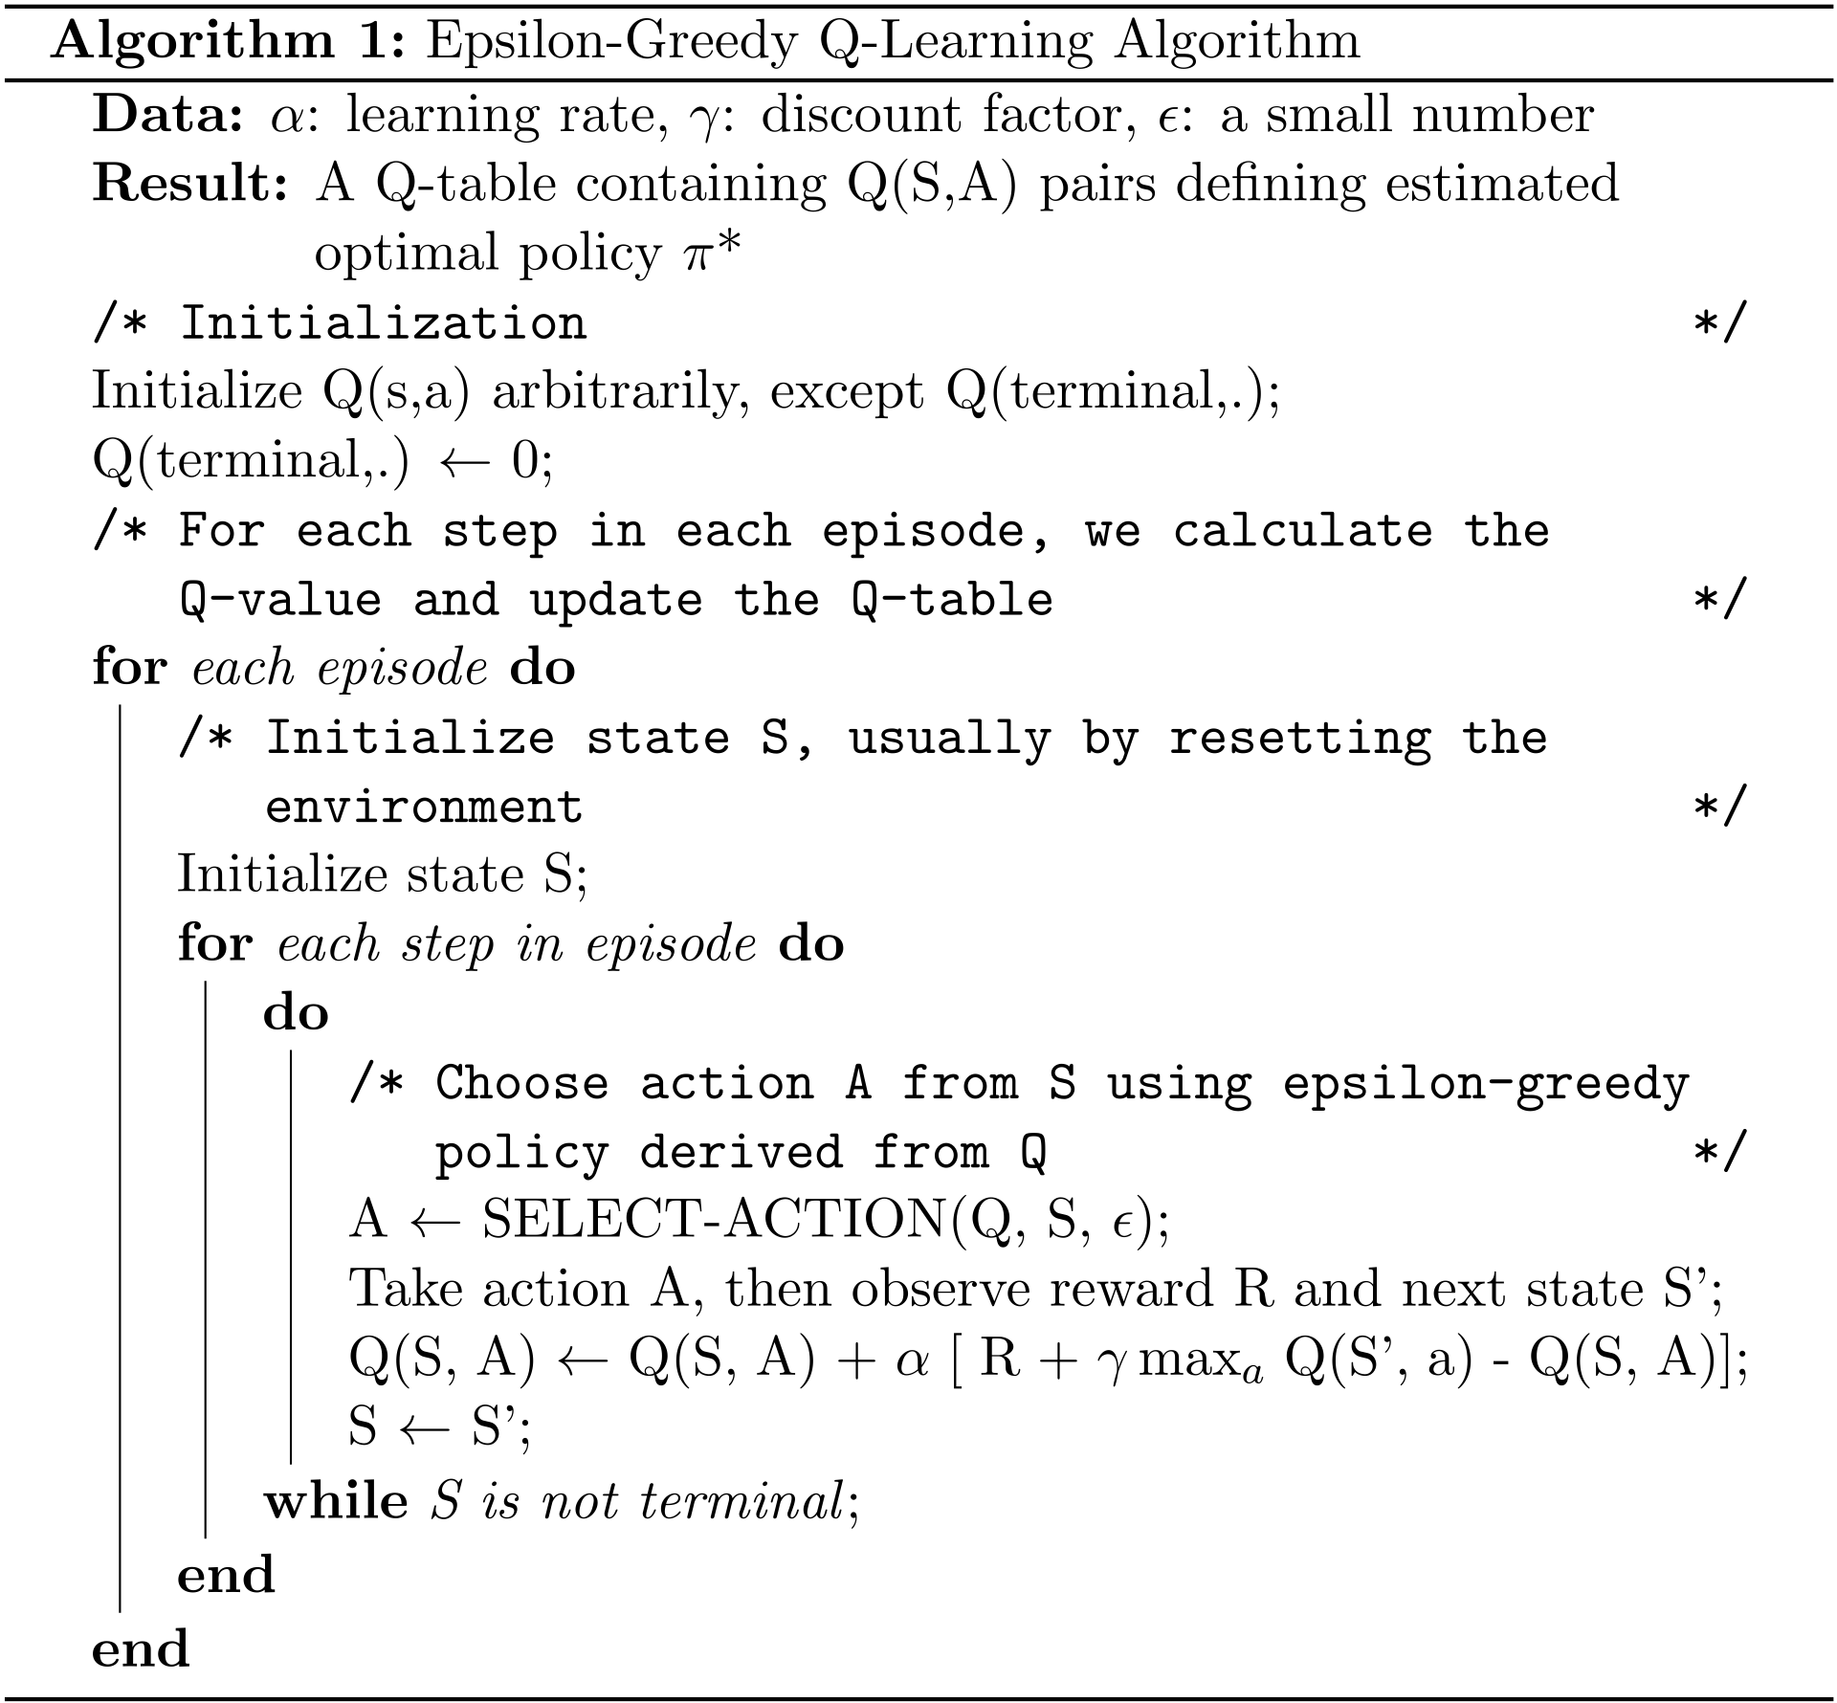
Implementation – Standard Q-Learning Details
Initialize discount factor gamma
Initialize exploration rate and epsilon decay rate
Initialize learning rate alpha
Initialize rewards in environment
Initialize Q matrix as zeros
Choose action for each agent according to epsilon-greedy policy
Observe reward of each agent
Get maximum Q-value for next state based on actions list
Update Q-value
Update decay rate equation
Repeat process until goal states achieved or max episodes reached

Slide 6
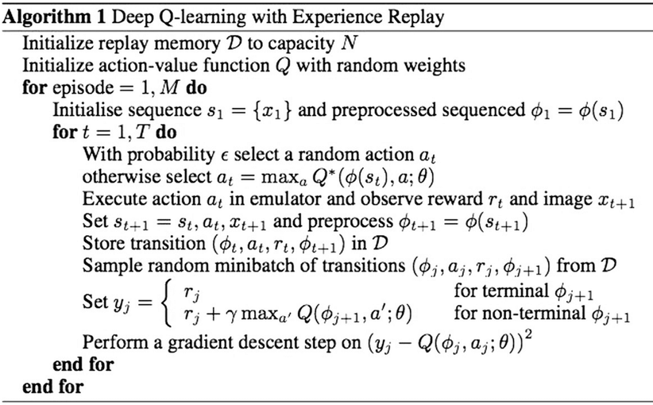
Implementation – DQN Details
Define network class for DQN:
List of layers that define architecture of the neural network (input/output/hidden)
Implemented via TensorFlow
Method to initialize weights of each layer using He initialization
Method for taking in an input layer and applying network’s layers to produce output tensor representing Q-values for each possible action
Method for taking in batch experiences and using it to update network weights using gradient descent optimizer
Define experience replay class for DQN:
A buffer for storing experiences implemented as deque data structure
Method for appending experiences to replay buffer
Method for sampling batch of experiences from replay buffer
Method for resetting the replay buffer

Slide 7
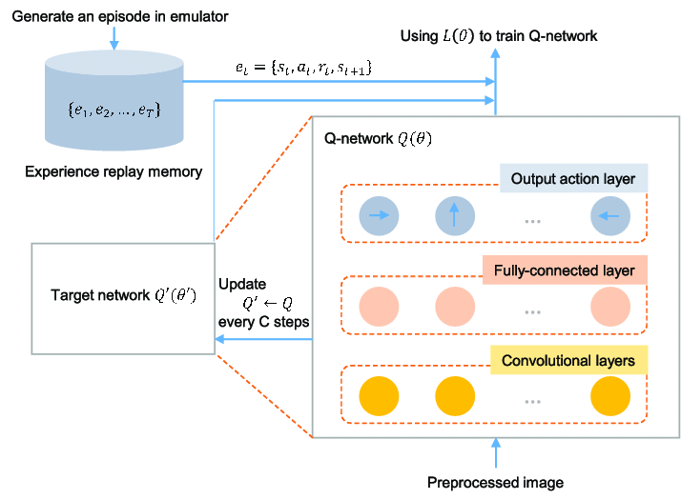
Implementation – DQN Details
Define agent class for DQN:
Network object for DQN
Experience Replay object for storing and sampling experiences
Method for selecting actions using epsilon-greedy selection policy
Method for updating Q-network using sample batches from replay buffer
Method for resetting agent and returning initial state of environment
Define Multi Agent class for DQN:
List of agent objects for each agent
Same methods in agent class but with joint execution

Slide 8
Implementation Steps – DQN
Define the grid world environment, including the size of the grid, the locations of obstacles and rewards, and any other relevant information.
Define the agents that will operate in the environment, including their goals, policies, and initial positions.
Initialize the neural network that will be used to approximate the action-value function Q(s, a) for each agent. This network should take in the current state of the environment and the actions of all the agents, and output the expected rewards for each agent.
Initialize the replay buffer that will be used to store and learn from past experiences. This buffer should store tuples of (state, action, reward, next state) for each agent.
For each time step in the environment:
Have each agent choose an action based on its current policy and the current state of the environment.
Update the state of the environment based on the actions of the agents.
Compute the rewards for each agent based on the new state of the environment and the agents' goals.
Store the experience (state, action, reward, next state) in the replay buffer for each agent.
Sample a mini-batch of experiences from the replay buffer, and use these experiences to update the weights of the neural network using the Bellman equation.
Continue this process for a specified number of time steps or until the agents reach their goals.
Evaluate the performance of the agents and the neural network, and make any necessary adjustments to improve the learning process.

Slide 9
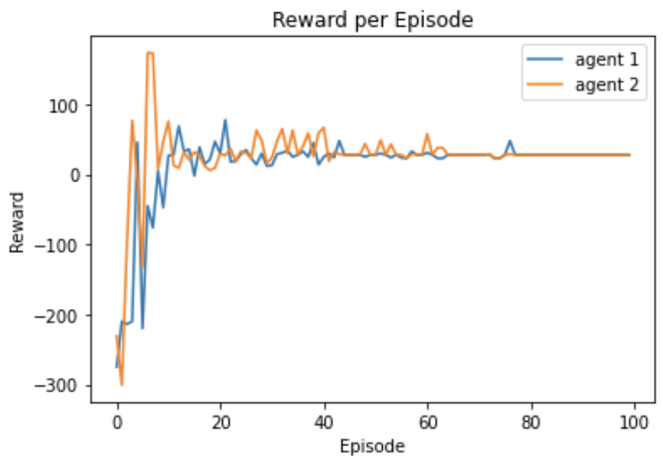
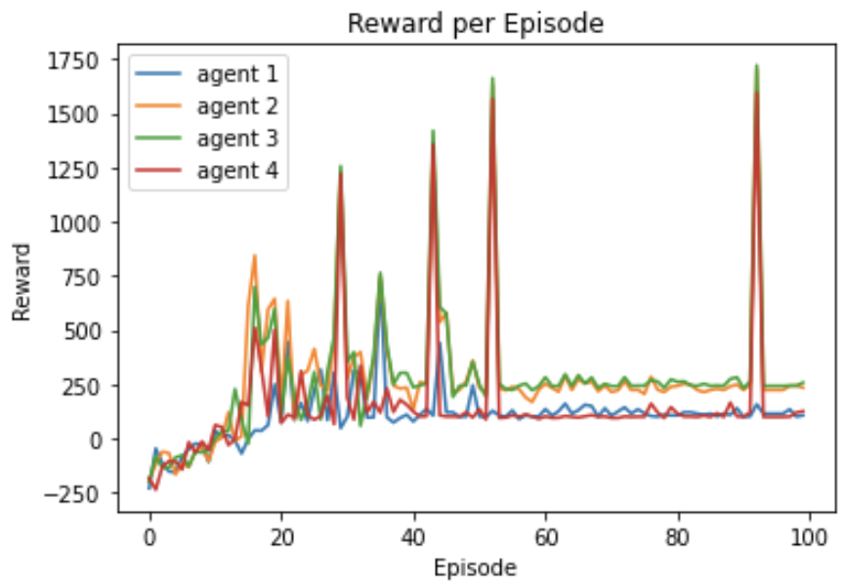
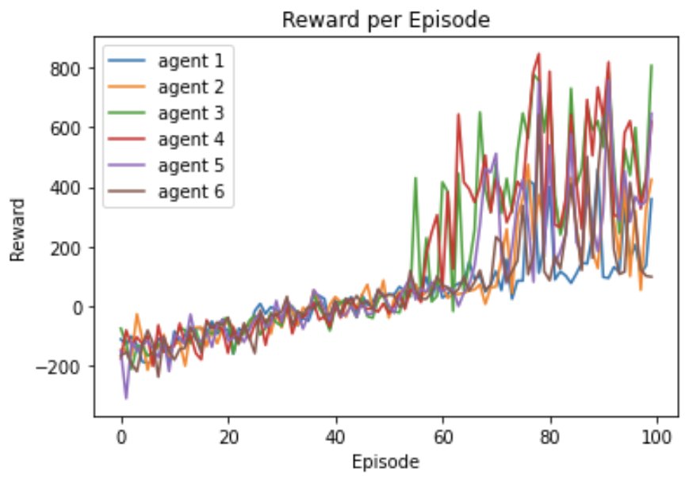
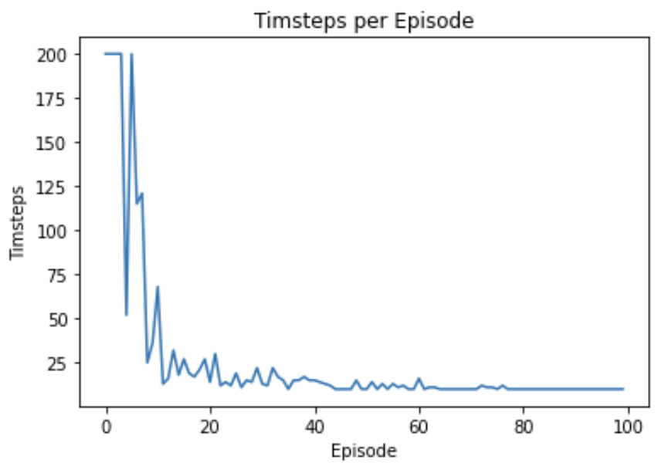
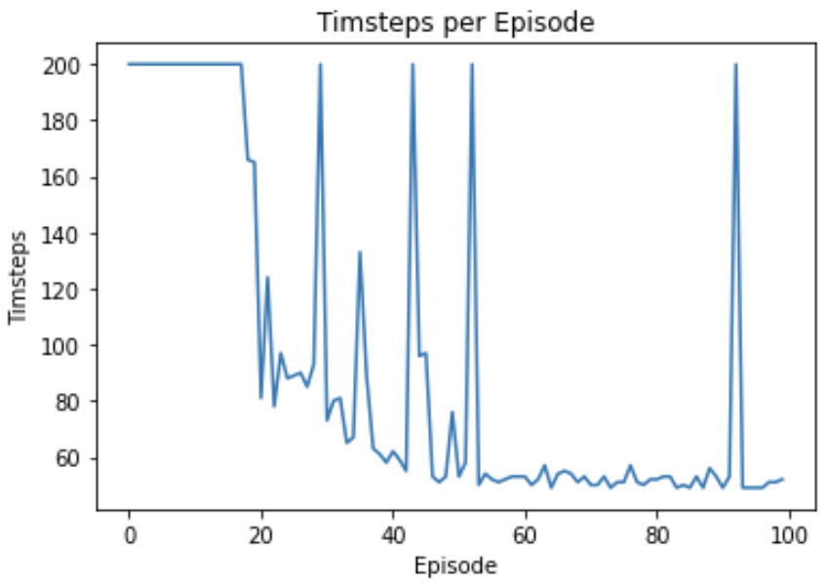
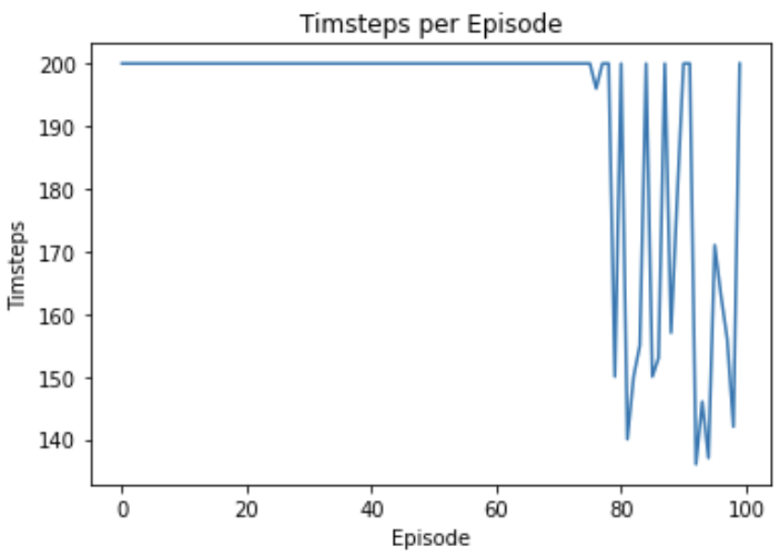
Results: Competitive Standard Q-Learning
2 Agents, 6x6 Grid, No Obstacles
4 Agents, 25x25 Grid, 10 Obstacles
6 Agents, 100x100 Grid, 30 Obstacles
Note: neque digni and in aliquet nisl et a umis varius.

Slide 10
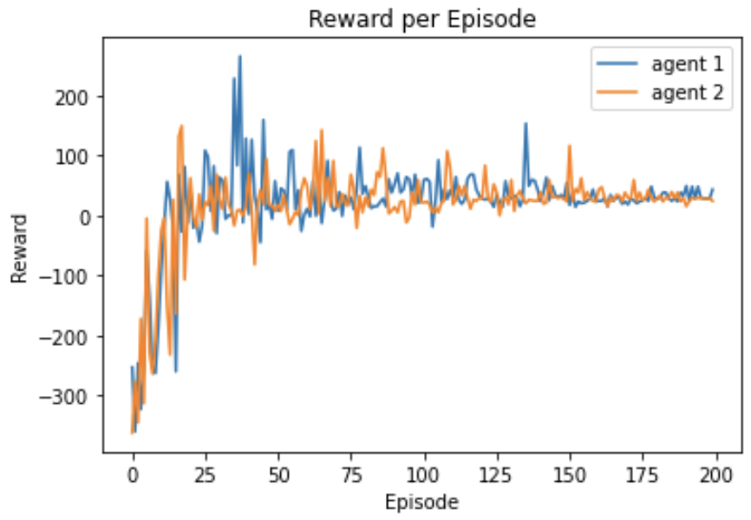
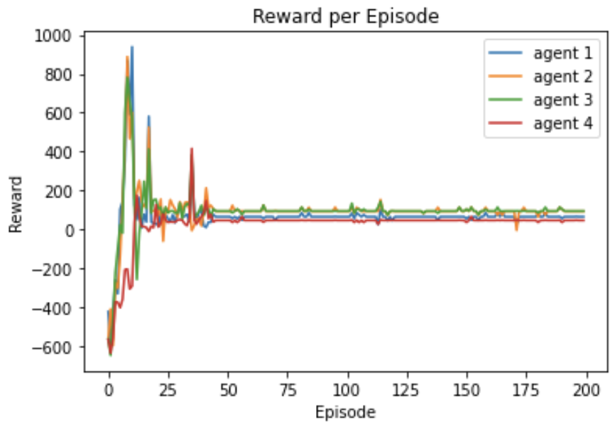
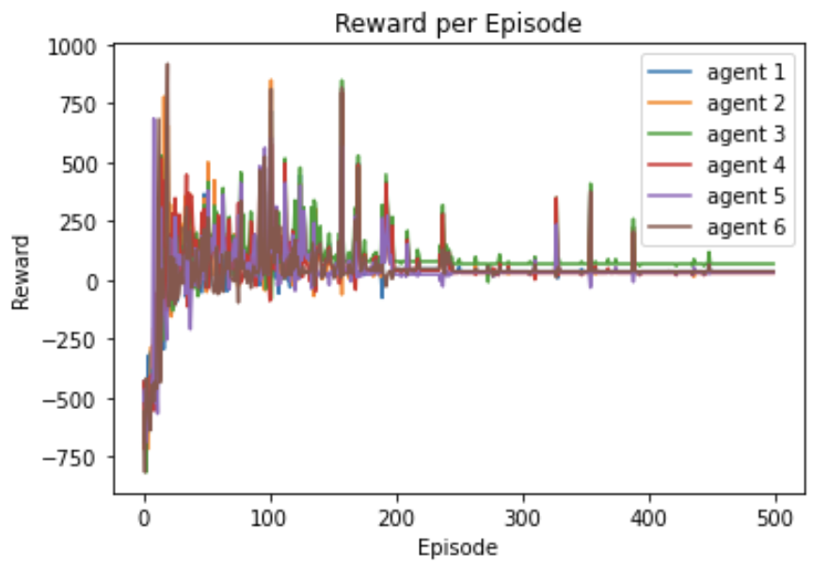
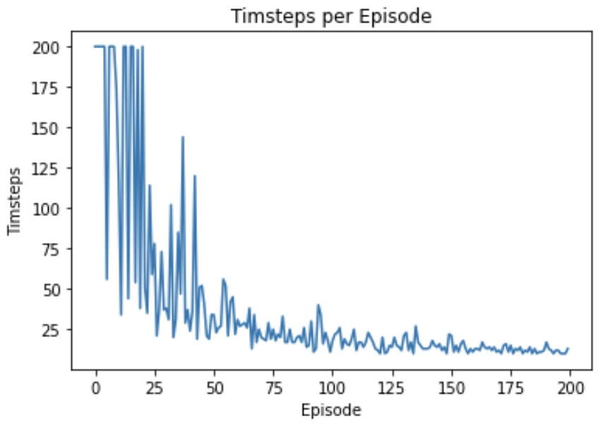
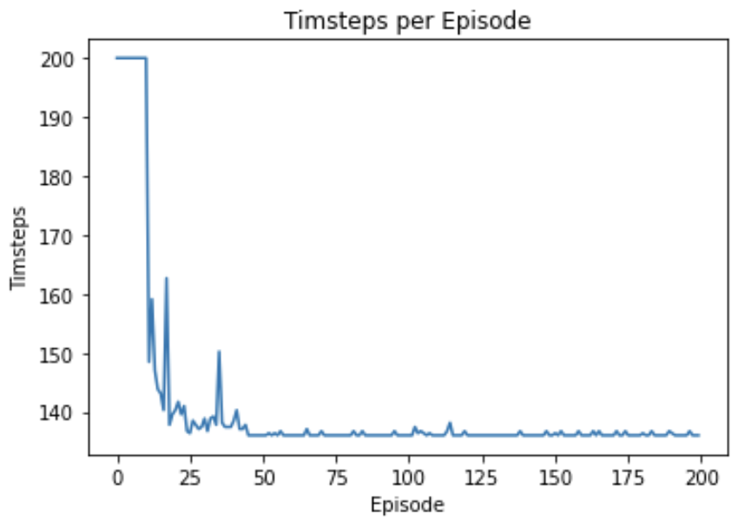
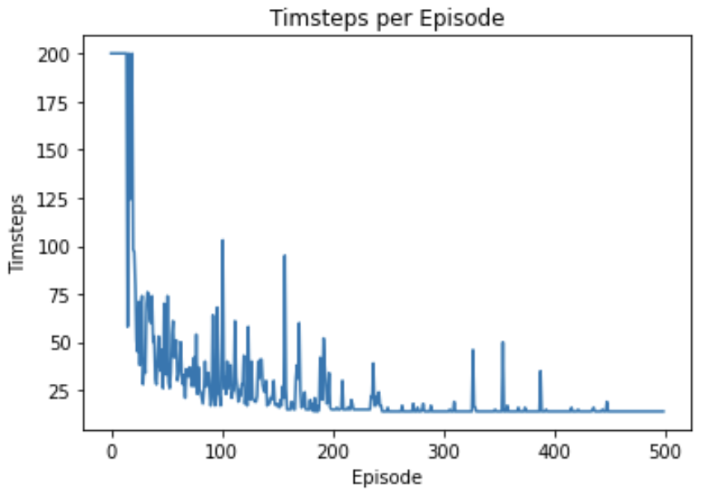
Results: Competitive Deep Q-Learning
2 Agents, 6x6 Grid, No Obstacles
4 Agents, 25x25 Grid, 10 Obstacles
6 Agents, 100x100 Grid, 30 Obstacles
Note: neque digni and in aliquet nisl et a umis varius.

Slide 11
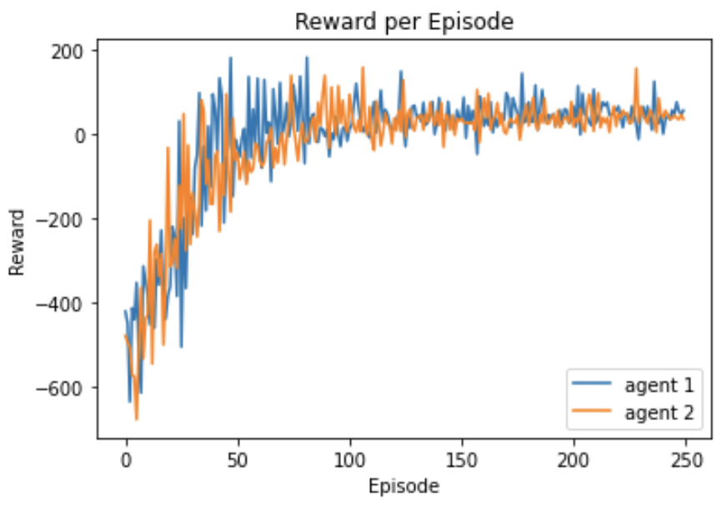
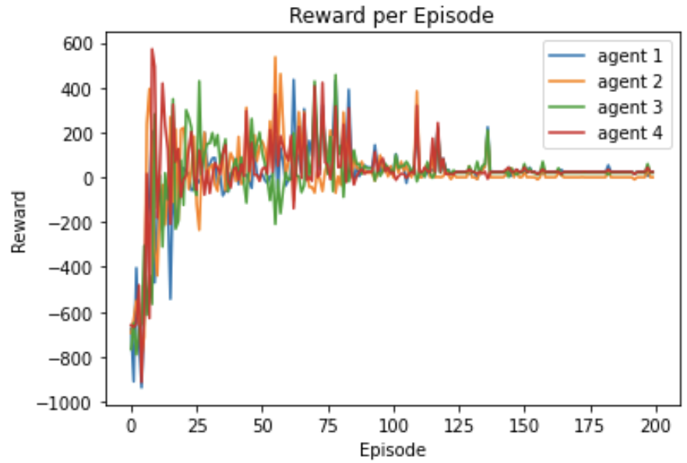
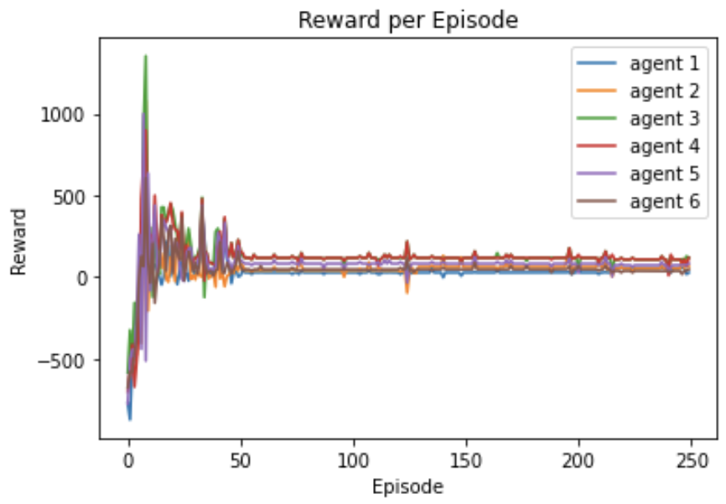
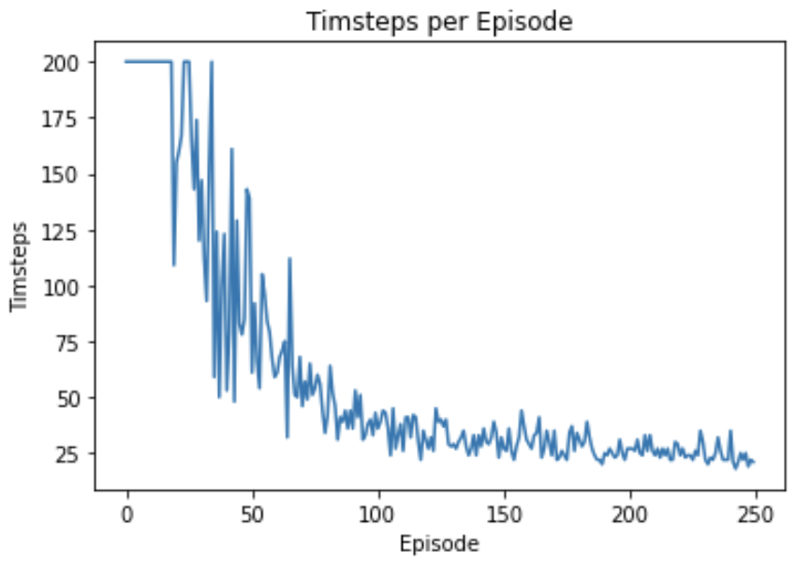
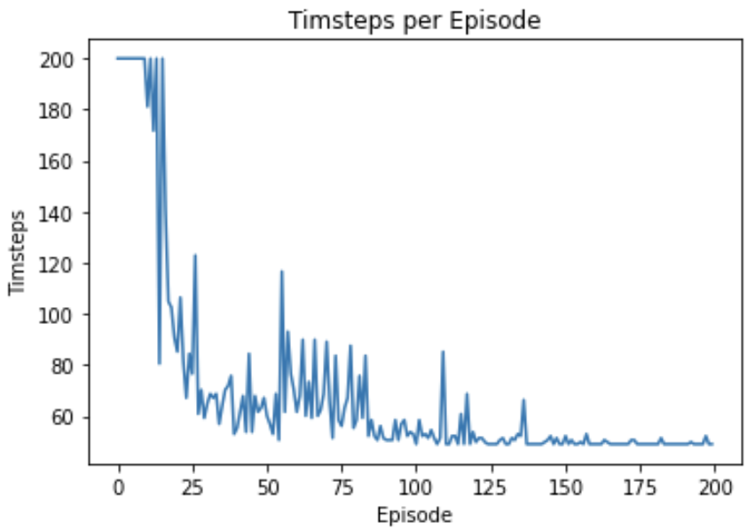
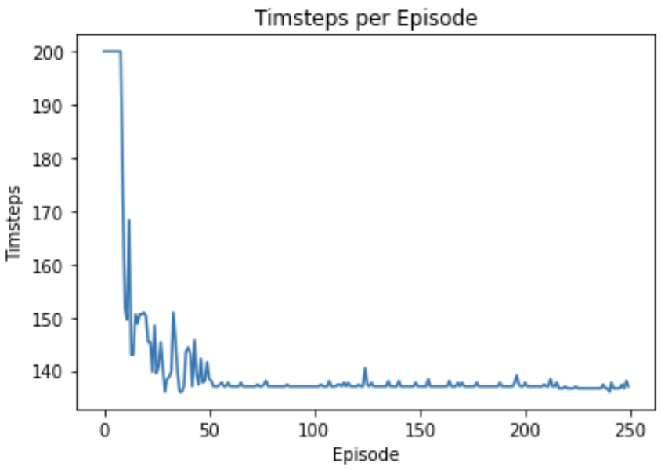
Results: Cooperative Deep Q-Learning
2 Agents, 6x6 Grid, No Obstacles
4 Agents, 25x25 Grid, 10 Obstacles
6 Agents, 100x100 Grid, 30 Obstacles
Note: neque digni and in aliquet nisl et a umis varius.

Slide 12
Results Summary
Table 1: Evaluation of Episodes to Convergence
Table 2: Shared Model Parameters
 | Comp Q-Learning | Comp Deep Q-Learning | Coop Deep Q-Learning
Scenario 1 | 85 episodes | 200 episodes | 250 episodes
Scenario 2 | 100 episodes (noisy) | 65 episodes | 150 episodes
Scenario 3 | Unstable | 300 episodes | 125 episodes
Model Parameters
Learning Rate | 0.7
Exploration Decay Rate | 0.03
Discount Factor | 0.9
Max Timesteps | 200
Note: neque digni and in aliquet nisl et a umis varius.

Slide 13
Key Observations
In a complex environment, it can be difficult for agent acting alone to learn an effective policy. Shared experience can help multiple agents learn more efficiently and improve their performance
In simpler environments, increased complexity of shared experience DQN may not be necessary, as regular Q-learning may be a more suitable choice
Cooperative tasks benefit greatly from centralized learning
Main Takeaway: Model complexity should be in line with environment/task complexity in order to allocate resources most effectively and efficiently. Just because a model is more intensive does not mean it will display superior performance.
Note: neque digni and in aliquet nisl et a umis varius.

Slide 14
Contribution Summary
Team Member | Contribution %
Kishan Patel | 100
Note: neque digni and in aliquet nisl et a umis varius.

Slide 15
Thank You!
Note: neque digni and in aliquet nisl et a umis varius.

